Slide 1
GBG EDUCATION
El mercado de Cedar Hollow
Spanish 1 · Grades 9-12
Sra. Montoya · Cedar Hollow High School
Lesson introduction · 50 minutes
Notes:
Bienvenidos. Today we work at the Cedar Hollow farmers market in Spanish: foods, numbers, and prices. By the end of class, every student will sell food to customers in Spanish.

Slide 2
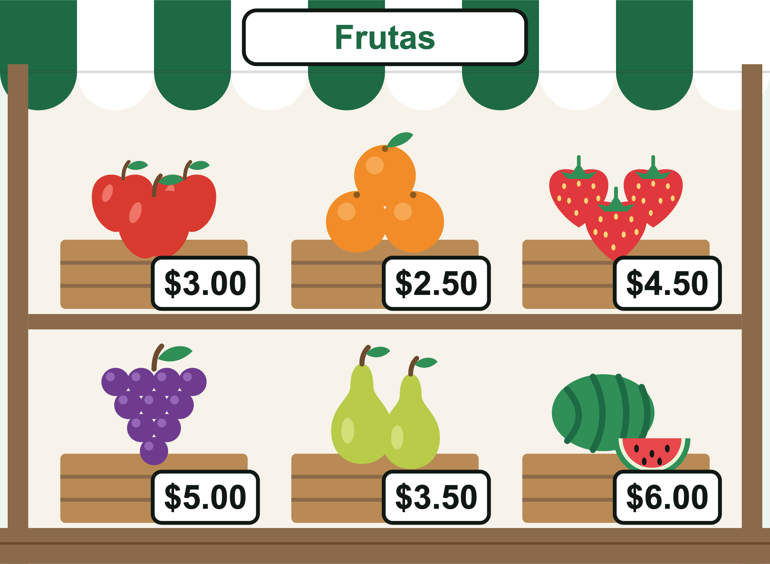
¿Qué hay en el mercado?
Look at the fruit stand. Which foods can you name?
Which fruit costs the most? The least?
How would you ask what something costs?
GBG Education · El mercado de Cedar Hollow
2
Notes:
Hook, about 2 minutes. Students turn and talk, then share. La sandía costs the most ($6.00) and las naranjas cost the least ($2.50). Collect guesses for asking a price but do not correct them yet: the answer comes on slide 6.

Slide 3
Hoy vamos al mercado
Learning target: I can shop at a market in Spanish.
I can name foods with el, la, los, las.
I can say a price like $4.50 in Spanish.
I can choose cuesta or cuestan to ask a price.
I can ask for food politely and finish a purchase.
GBG Education · El mercado de Cedar Hollow
3
Notes:
Read the target and the I can statements aloud. Tell students they will rate themselves on each one at the end of class (slide 10).

Slide 4
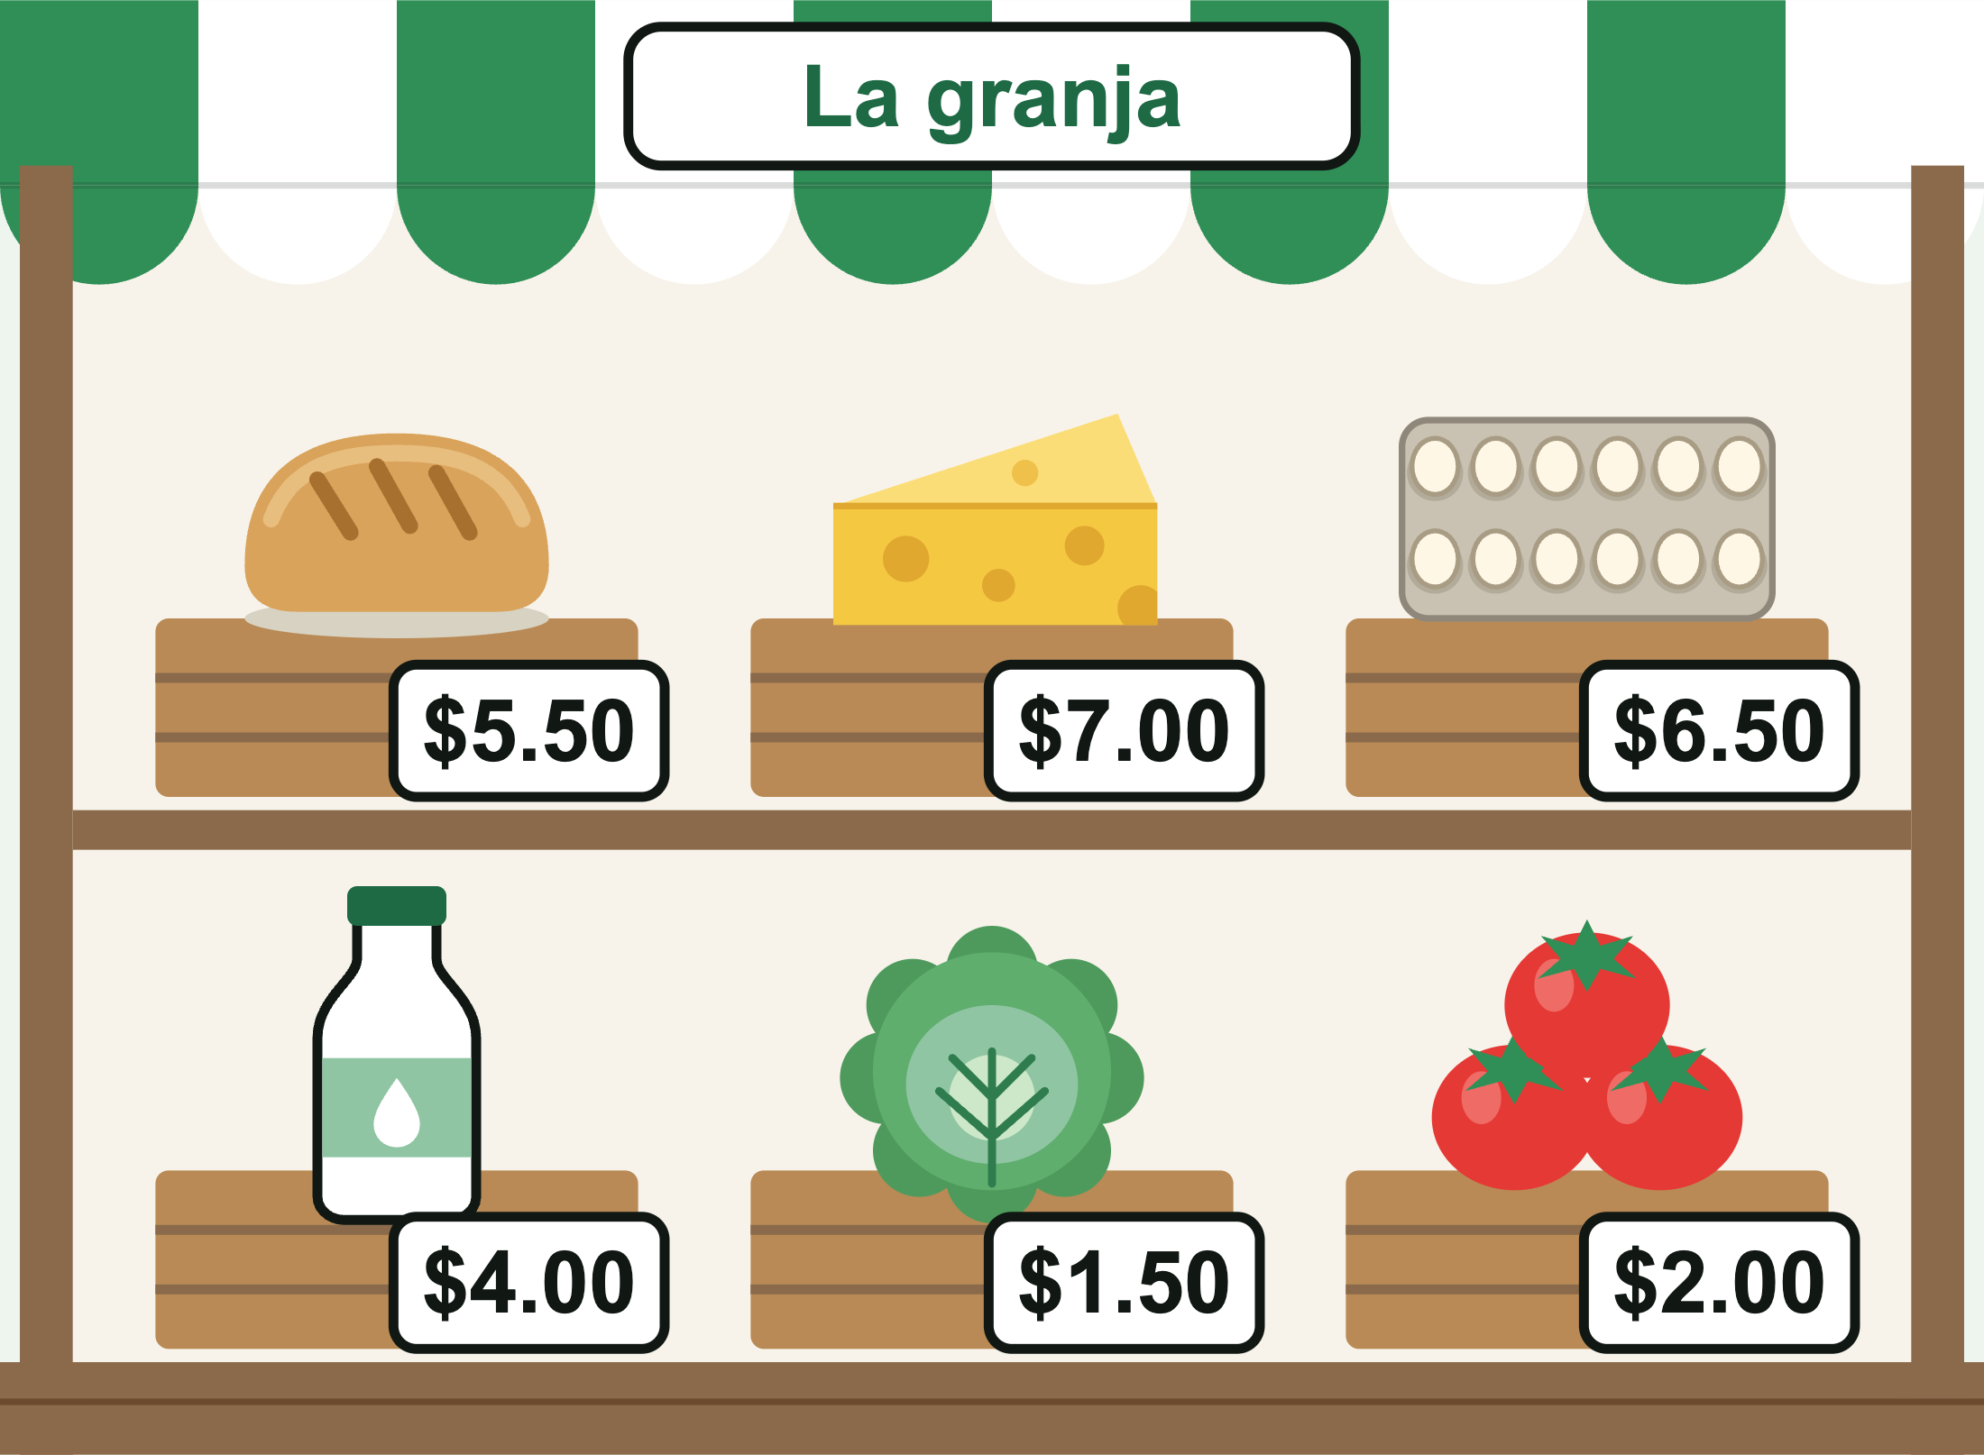
Las frutas y la granja
Frutas: las manzanas, las naranjas, las fresas, las uvas, las peras, la sandía
La granja: el pan, el queso, los huevos, la leche, la lechuga, los tomates
una docena de huevos = 12 eggs
la leche is feminine, even though it ends in -e
GBG Education · El mercado de Cedar Hollow
4
Notes:
Choral repetition: say each word with its article and have students repeat. Point to the food on the stand as you say it. Ask: why las manzanas but la sandía? (plural vs. one). Flag la leche: it ends in -e but it is feminine. Prices on both stands are the same ones used in the game and on the worksheets.

Slide 5
Los números y los precios
11 once, 12 doce, 13 trece, 14 catorce, 15 quince
16 dieciséis, 17 diecisiete, 18 dieciocho, 19 diecinueve, 20 veinte
$3.00 = tres dólares
$2.50 = dos dólares con cincuenta centavos
$1.50 = un dólar con cincuenta centavos
GBG Education · El mercado de Cedar Hollow
5
Notes:
Model the pattern: dollars, then con, then cents. One dollar is singular: un dólar. Watch the look-alikes: doce (12) vs. dos (2), and dieciséis (16) vs. seis (6). Quick drill: say a price from the stands and have students hold up fingers for the dollars.

Slide 6
¿Cuesta o cuestan?
One thing: ¿Cuánto cuesta el queso? Cuesta siete dólares.
More than one: ¿Cuánto cuestan las fresas? Cuestan cuatro dólares con cincuenta centavos.
Check the article: el, la, un, una: cuesta. los, las: cuestan.
una docena de huevos is one dozen, so it cuesta.
GBG Education · El mercado de Cedar Hollow
6
Notes:
Worked example. Think aloud: I see el queso, el means one, so I use cuesta. I see las fresas, las means more than one, so I use cuestan. The answer uses the same verb as the question. Compare: ¿Cuánto cuestan los huevos? but ¿Cuánto cuesta una docena de huevos?

Slide 7
En el mercado: una conversación
Vendedor: Buenos días. ¿Qué desea?
Cliente: Quisiera el pan, por favor. ¿Cuánto cuesta?
Vendedor: Cuesta cinco dólares con cincuenta centavos. ¿Algo más?
Cliente: No, gracias. Es todo. Aquí tiene.
Vendedor: Gracias. ¡Hasta luego!
GBG Education · El mercado de Cedar Hollow
7
Notes:
Model the conversation with a student, then pairs read it twice and switch roles. Then they swap in a different food and its price from the stands. Quisiera (I would like) is a little more polite than Quiero (I want); both work with por favor. In the game, students are the seller: they answer ¿Qué desea? customers, say prices, and say De nada. ¡Hasta luego!

Slide 8
Quick check: write it on your board
1. ¿Cuánto ____ la sandía?
2. ¿Cuánto ____ los tomates?
3. ¿Cuánto ____ una docena de huevos?
4. Write $6.50 in Spanish words.
5. Ask for the cheese politely.
GBG Education · El mercado de Cedar Hollow
8
Notes:
Answers: 1. cuesta. 2. cuestan. 3. cuesta. 4. seis dólares con cincuenta centavos. 5. Quisiera el queso, por favor (Quiero el queso, por favor is also correct). If more than a few boards are wrong, re-model with slide 6 before releasing play.

Slide 9
Juega: El mercado de Cedar Hollow
You run a stall at el mercado for 3 market days.
Type your class code: MONT-ES1-1, -2, or -3.
Answer customers in Spanish, find their food, and say prices.
Read aloud speaks Spanish only if your device has a Spanish voice.
At the end, copy your completion code and submit it.
GBG Education · El mercado de Cedar Hollow
9
Notes:
Write the three codes on the board by group. Same code, same customers in the same order, so a group can compare afterward. Each morning students do a job for Sra. Ríos (load the truck, ask a price, set a price tag, or write the sign), then serve two customers. Right answers earn stars, sales, and tips. Play takes about 10 to 12 minutes. Level 1 gets word help, hints, and a second try; Level 2 gets word help and hints; Level 3 has none. Read aloud uses a Spanish voice only where the device has one installed (most Chromebooks and Macs); other devices may read the Spanish with an English voice, so the on-screen text is the main support. To check codes, tap Made by GBG Education 5 times and enter the passphrase from the lesson plan (keep it private; notes can show on a shared screen).

Slide 10
Boleto de salida (exit ticket)
1. Write your completion code.
2. Ask the price of las uvas.
3. Write $4.50 in Spanish words.
4. You buy las manzanas and la leche. ¿Cuánto es todo?
Rate yourself 1 to 3 on each I can statement.
GBG Education · El mercado de Cedar Hollow
10
Notes:
Answers: 2. ¿Cuánto cuestan las uvas? 3. cuatro dólares con cincuenta centavos. 4. $3.00 + $4.00 = $7.00: Son siete dólares. Sort the tickets into got it, almost, and not yet for tomorrow's warm-up.

