Slide 1
GBG EDUCATION
Food Web Rescue
Science · Grade 7
Mr. Brennan · Cedar Hollow Middle School
Lesson introduction · 50 minutes
Notes:
Welcome, rangers. Today we restore Cedar Hollow Preserve: who eats whom, where the energy goes, and what happens when one population changes. Everything today uses the same three food webs you will see in the game and on your worksheet.

Slide 2
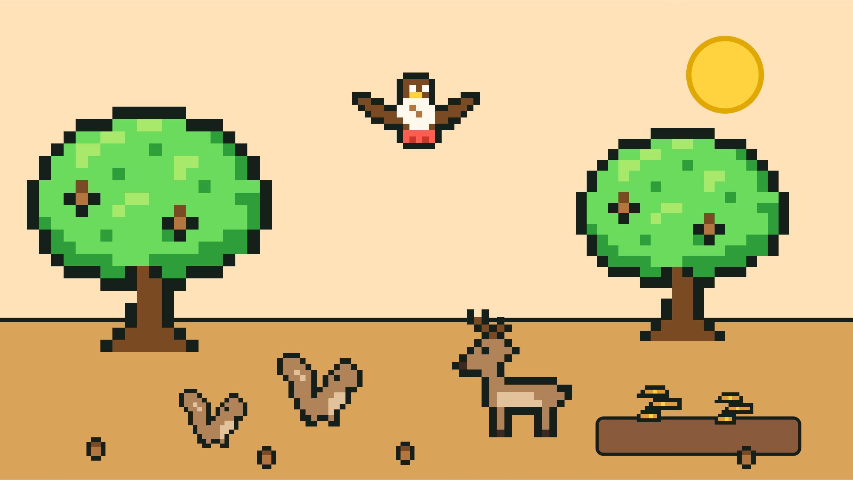
Ranger report: the hawks are gone
The hawks leave Cedar Hollow Woods.
Which animals win? Which animals lose?
Turn and talk: make a prediction and give a reason.
GBG Education · Food Web Rescue
2
Notes:
Tell students they are the new rangers of Cedar Hollow Preserve today. Give 90 seconds to turn and talk, then collect three predictions on the board without correcting them. We come back to these at the end of class. (In our woods food web, hawks eat squirrels, and squirrels and deer eat acorns from the oak trees. Do not reveal this yet.)

Slide 3
Today's targets
I can sort producers, consumers, and decomposers.
I can draw arrows from the food to the eater.
I can estimate energy with the 10 percent rule.
I can predict what most likely happens when a population changes.
GBG Education · Food Web Rescue
3
Notes:
Read the targets aloud. Point out that the game, the worksheet, and the exit ticket all check these same four things. Ask students to rate themselves 1 to 4 on each target silently; they rate again at the end.

Slide 4
Ranger vocabulary
Producer: makes its own food from sunlight
Consumer: eats other living things to get energy
Decomposer: breaks down dead things and returns nutrients
Food web: connected food chains in one ecosystem
Energy pyramid: less energy at each level up
GBG Education · Food Web Rescue
4
Notes:
Give Cedar Hollow examples: algae, cattails, grass, and oak trees are producers; snails, muskrats, rabbits, squirrels, and deer are primary consumers; sunfish, foxes, and hawks are secondary consumers; herons are tertiary consumers; pond bacteria, mushrooms, and shelf fungus are decomposers. Consumer levels count the feeding steps after the producer.

Slide 5
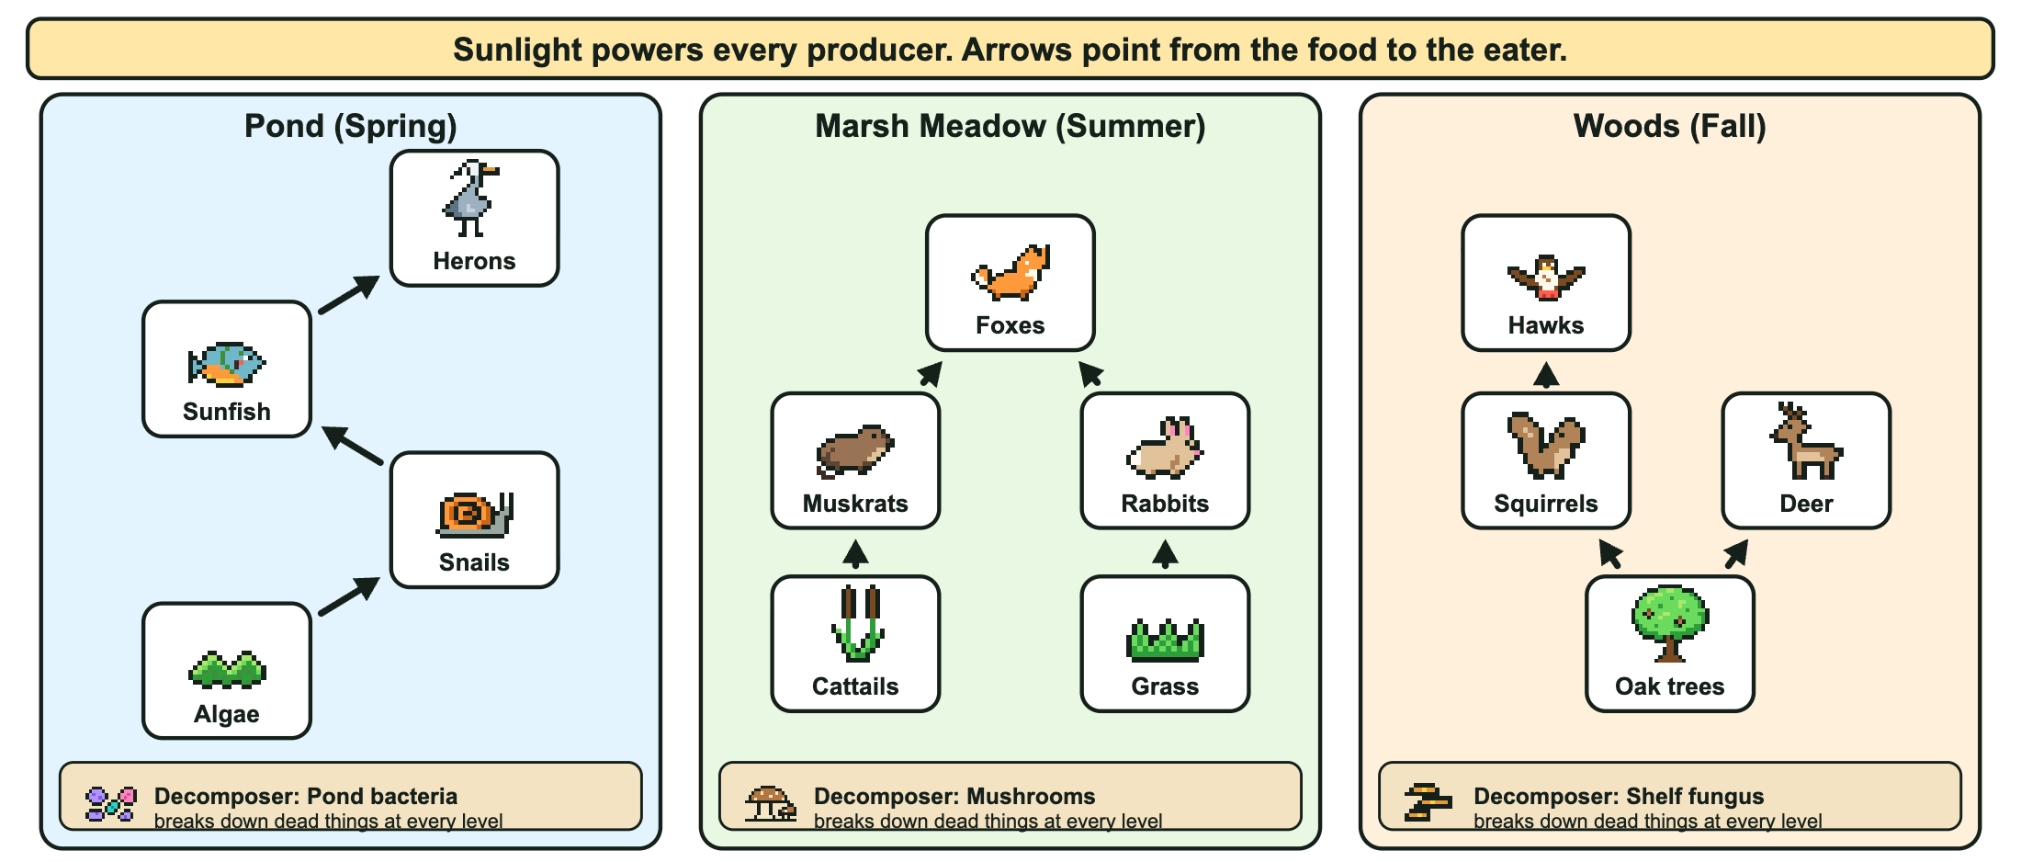
Arrows point from the food to the eater
GBG Education · Food Web Rescue
5
Notes:
These are the same three food webs students restore in the game, one per season. Model one arrow: Grass to Rabbits means rabbits eat grass, so energy flows from the grass into the rabbits. Ask: what eats the muskrats? (One arrow leaves the muskrats: foxes.) Point out that each habitat has a decomposer that breaks down dead things from every level. Remind students that real animals eat more than these webs show, so we always answer for this food web.

Slide 6
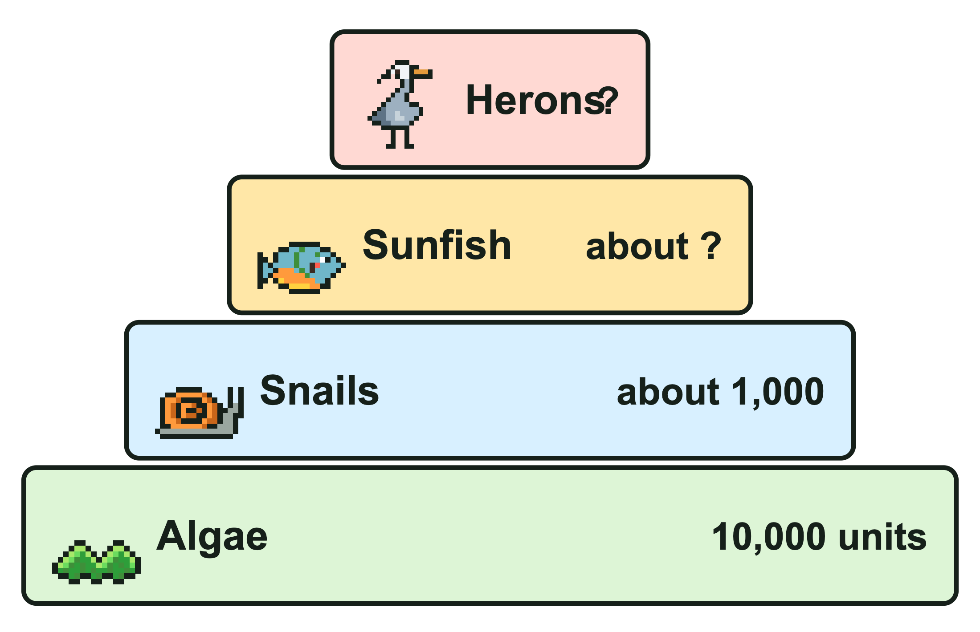
Energy shrinks at each level
Each level gets about 10 percent of the level below.
It is a rule of thumb: the real amount varies.
Algae 10,000 units, snails about 1,000, sunfish about ?
Most energy is used to live, and much is given off as heat.
GBG Education · Food Web Rescue
6
Notes:
Worked example: 10 percent of about 1,000 is about 100, so the sunfish get about 100 units and the herons about 10. Stress that 10 percent is an approximation, not an exact law. Ask: why are there thousands of snails but only a few herons? (Less energy is available at the top of the web, so it supports only a few top predators.) The game's energy check uses this same pond chain.

Slide 7
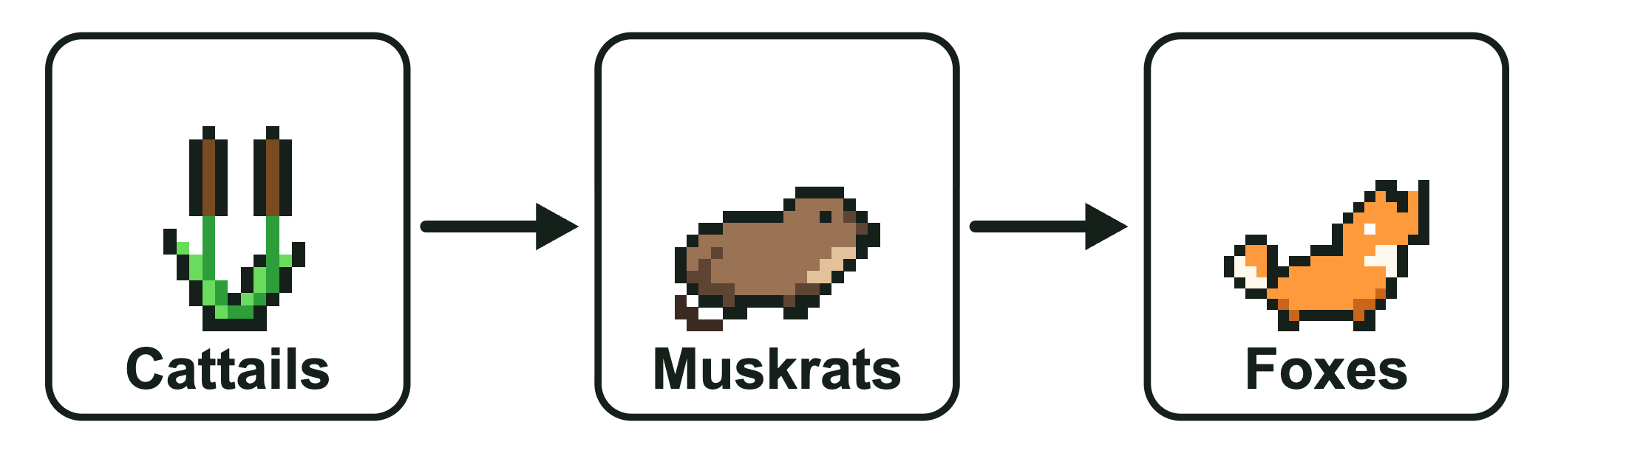
Worked example: the foxes leave
1. Find the arrows into the foxes: muskrats, rabbits.
2. Fewer get eaten, so they most likely increase at first.
3. Follow the next arrow: muskrats are the only animals that eat cattails, so more muskrats eat more cattails.
4. So cattails most likely decrease later.
GBG Education · Food Web Rescue
7
Notes:
Think aloud using the Marsh Meadow web (this is one of the summer events in the game). Say "most likely" and "at first" on purpose: real ecosystems can respond in more complicated ways. Point out the indirect effect in step 4: removing a predator changed a producer two steps away. The grass works the same way through the rabbits, because rabbits are the only grass eaters in this web.

Slide 8
Quick check
1. Squirrels eat acorns from oak trees. Which way does the arrow point?
2. Snails get about 1,000 units. About how much reaches the sunfish?
3. Most of the sunfish get sick and die. What most likely happens to the snails at first?
GBG Education · Food Web Rescue
8
Notes:
Answers: (1) Oak trees to Squirrels, from the food to the eater. (2) About 100 units. (3) The snails most likely increase at first, because in this food web sunfish are the only animals that eat snails. Students who miss question 1 start the game on Level 1; move confident students to Level 3.

Slide 9
Play Food Web Rescue
Open the game from our class page.
Class code: BREN7-1, BREN7-2, or BREN7-3.
Each season: place, connect, run the season.
At the end, copy your completion code into the assignment.
GBG Education · Food Web Rescue
9
Notes:
Write each group's code on the board. Level 1 sorts producers, consumers, and decomposers with three choices, one arrow per habitat, and a second try. Level 2 uses consumer levels, two arrows per habitat, and hints. Level 3 asks for arrows from field notes and two-step predictions, with no hints. The Read aloud buttons read every task out loud. To check a code, tap the small Made by GBG Education credit 5 times and enter the passphrase heron pond.

Slide 10
Exit ticket: ranger report
1. Write your completion code.
2. Hawks eat squirrels. Draw the arrow.
3. The hawks leave. What most likely happens to the squirrels at first? To the acorns later? Why?
GBG Education · Food Web Rescue
10
Notes:
Answers: (2) Squirrels to Hawks. (3) The squirrels most likely increase at first, because hawks were the only predators eating them in this web. Later, more squirrels eat more acorns, so the acorns most likely decrease. Return to the hook predictions: which ones held up? Students re-rate themselves on the four targets.

