Slide 1
GBG EDUCATION
Cedar Hollow Slice Shop
Math · Grade 4
Ms. Delgado · Cedar Hollow Elementary
Lesson introduction · 45 minutes
Notes:
Welcome, bakers. Today we run the Cedar Hollow Slice Shop. We will cut pies into equal slices, find fractions that name the same amount, and compare, add, and take away fractions. Then you will play Cedar Hollow Slice Shop at your level and finish with a worksheet.

Slide 2
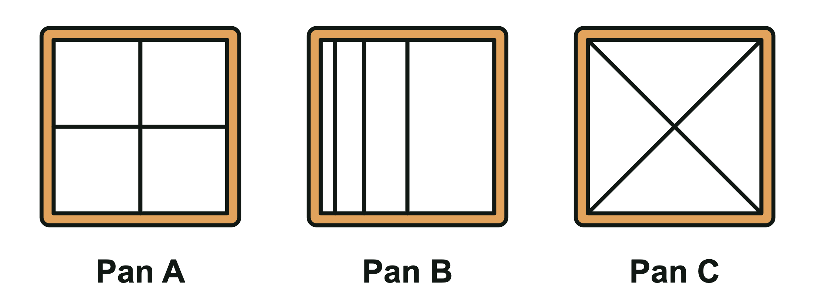
Which pans are cut into fourths?
The Slice Shop bakes square pan pies too.
Each pan must be cut into fourths.
Which pans work? Turn and talk: how do you know?
GBG Education · Cedar Hollow Slice Shop
2
Notes:
Give students 30 seconds, then vote with fingers (1 for Pan A, 2 for Pan B, 3 for Pan C; more than one is allowed). Answer: Pans A and C. Pan B has 4 parts, but they are not the same size, so they are not fourths. Pan C surprises some students: its 4 triangles are exactly the same size, so each is 1/4 even though the pieces look different from Pan A. Then hand out paper circles. Fold in half, then in half again. Ask: how many equal parts now? What do we call each part? (Four fourths.)

Slide 3
Today's learning target
Support: I can name halves, thirds, and fourths.
On Level: I can find equivalent fractions.
Challenge: I can compare, add, and take away fractions.
Everyone: equal slices come first!
GBG Education · Cedar Hollow Slice Shop
3
Notes:
Read the targets aloud. Every level starts from the same big idea: a fraction only makes sense when the whole pie is cut into equal slices. Tell students they will come back to these I can statements on the exit ticket.

Slide 4
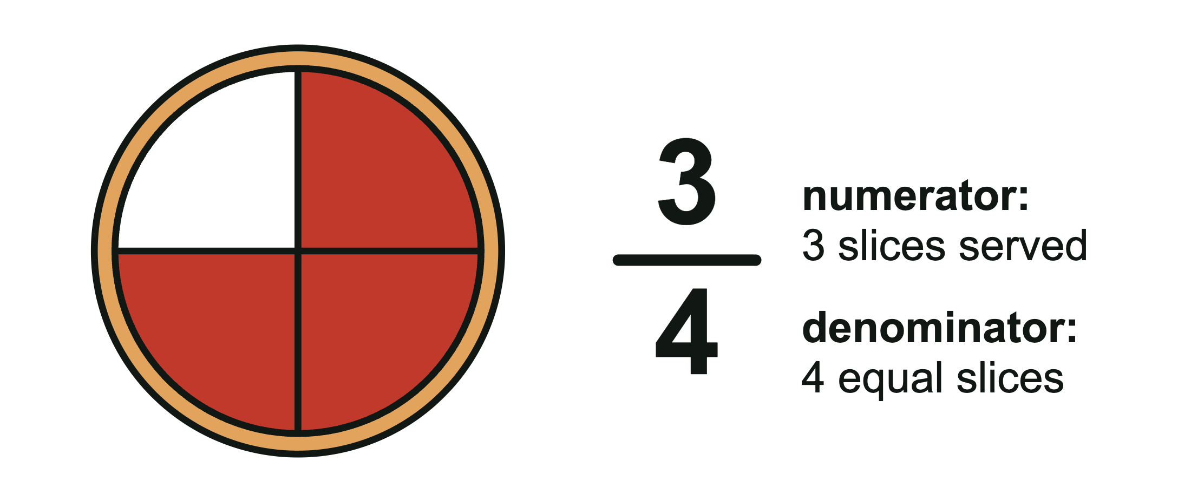
Key vocabulary
Numerator: slices we count (top)
Denominator: equal slices in the whole (bottom)
Equivalent fractions: same amount, new name
Benchmark: a fraction we know well, like 1/2
Mixed number: like 1 1/4
GBG Education · Cedar Hollow Slice Shop
4
Notes:
Point to the pie: 4 equal slices, 3 served, so 3/4 of the pie is served. The 3 is the numerator and the 4 is the denominator. Mixed numbers are written in standard form, 1 1/4. On the board, write the fraction stacked beside the whole number (the game does the same) so 1 1/4 is not misread as 11/4. Read it aloud as one and one fourth.

Slide 5
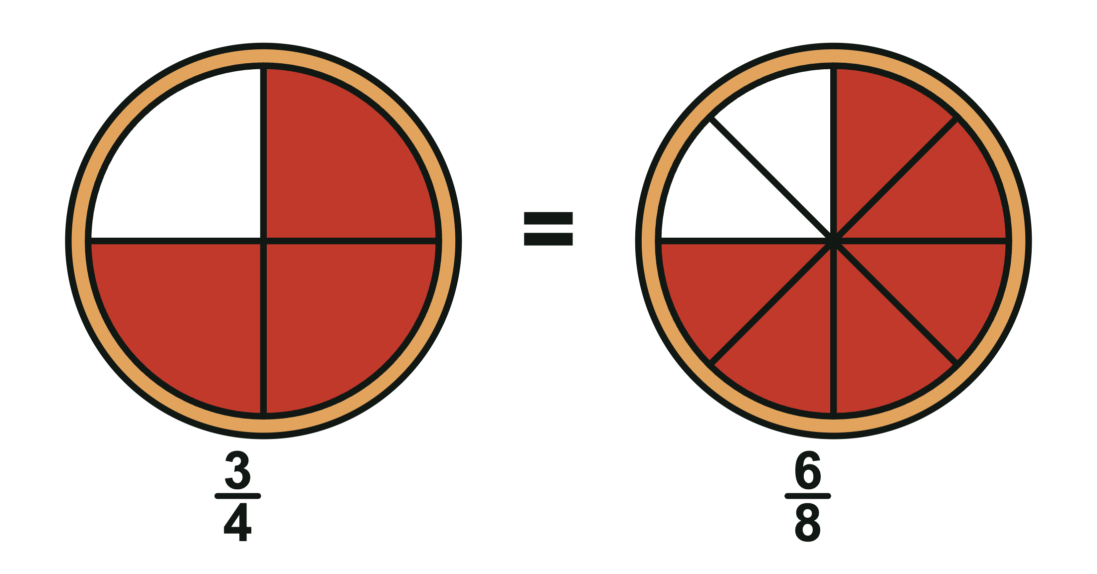
Model: equivalent fractions
3/4 of a pie is the same amount as 6/8.
Cut each fourth into 2 slices: 3/4 = 6/8.
Multiply the top and bottom by the same number: 3 times 2 = 6, 4 times 2 = 8.
GBG Education · Cedar Hollow Slice Shop
5
Notes:
In the game, a customer asks for 3/4 of a pie, but today's pies are cut into 8 slices. Ask: how many slices do we serve? (6.) The slices got smaller, but there are more of them, so the amount stays the same. Ask: how many eighths make 1/2? (4, so 1/2 = 4/8.) Point out that adding the same number to the top and bottom does not work: 3/4 is not equal to 4/5.

Slide 6
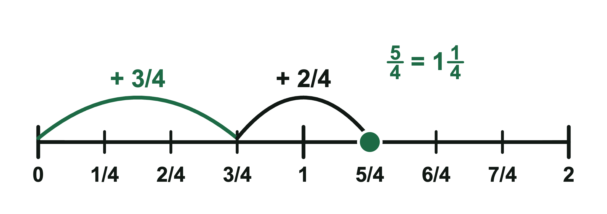
Model: compare, add, and take away
Compare with 1/2: 3/8 < 1/2 and 4/6 > 1/2, so 4/6 is greater.
Like denominators: add or take away the tops, keep the bottom.
3/4 + 2/4 = 5/4 = 1 1/4
GBG Education · Cedar Hollow Slice Shop
6
Notes:
Comparing: half of 8 is 4, so 3/8 is less than 1/2. Half of 6 is 3, so 4/6 is more than 1/2. Adding: on the number line, jump 3 fourths from 0, then 2 more fourths. We land on 5/4. Since 4/4 is 1 whole pie, 5/4 is 1 1/4 pies. The denominator stays 4 because the size of the slices does not change. A common mistake is 3/4 + 2/4 = 5/8; ask students why that cannot be right (5/8 is less than 3/4, but we added more). Taking away works the same way: a whole pie cut into 8 slices is 8/8, and if a customer buys 3/8, then 8/8 - 3/8 = 5/8 is left.

Slide 7
Quick check
1. A pie is cut into 8 slices. How many slices make 1/2?
2. Which is greater: 2/8 or 2/6?
3. What is 2/5 + 2/5?
GBG Education · Cedar Hollow Slice Shop
7
Notes:
Students show answers on fingers or whiteboards. Answers: 1. 4 slices, because half of 8 is 4 (1/2 = 4/8). 2. 2/6, because sixths are bigger slices than eighths. 3. 4/5 (add the numerators, keep the fifths). Use the results to confirm levels: students unsure about equal slices start at Support (DEL4-1), students who get question 1 play On Level (DEL4-2), and students who get all three can try Challenge (DEL4-3).

Slide 8
How to play Slice Shop
Open the game from our class page.
Type your class code: DEL4-1 Support, DEL4-2 On Level, DEL4-3 Challenge.
Read each order. Tap slices or a card, then serve.
At the end, type your completion code into the assignment.
GBG Education · Cedar Hollow Slice Shop
8
Notes:
A run is 3 days in the shop: 12 customers at Support, 13 at On Level, and 14 at Challenge, about 10 to 15 minutes. Right orders earn coins and stars. Between days, students spend coins on shop upgrades, which never change the answers. Support has hints and a second try; On Level has hints; Challenge has no hints. Everyone with the same code gets the same customers, so partners can compare answers. To check a completion code, tap the small Made by GBG Education credit 5 times, enter the teacher passphrase, and type the code to see the score and level.

Slide 9
Exit ticket
Write your completion code.
Support: Draw a pie cut into 3 equal slices. Shade 1/3.
On Level: Write two fractions equal to 3/4.
Challenge: 2/5 + 4/5 = ? Write it as a mixed number.
Which I can statement did you meet today?
GBG Education · Cedar Hollow Slice Shop
9
Notes:
Answers: Support: a circle cut into 3 equal slices with 1 slice shaded. On Level: any two of 6/8, 9/12, or 75/100. Challenge: 2/5 + 4/5 = 6/5 = 1 1/5. Collect tickets at the door and use them with the completion codes to plan tomorrow's groups.

