Slide 1
GBG EDUCATION
Cedar Hollow Case Files
ELA · Grade 8
Ms. Whitaker · Cedar Hollow Middle School
Lesson introduction · 50 minutes
Notes:
Welcome, detectives. The Golden Pie trophy for the Fall Festival Bake-Off is missing, and the only clues are written in figurative language. Some sentences mean exactly what they say, and some say much more. By the end of class you will be able to spot five kinds of figurative language and decode what each one really means.

Slide 2
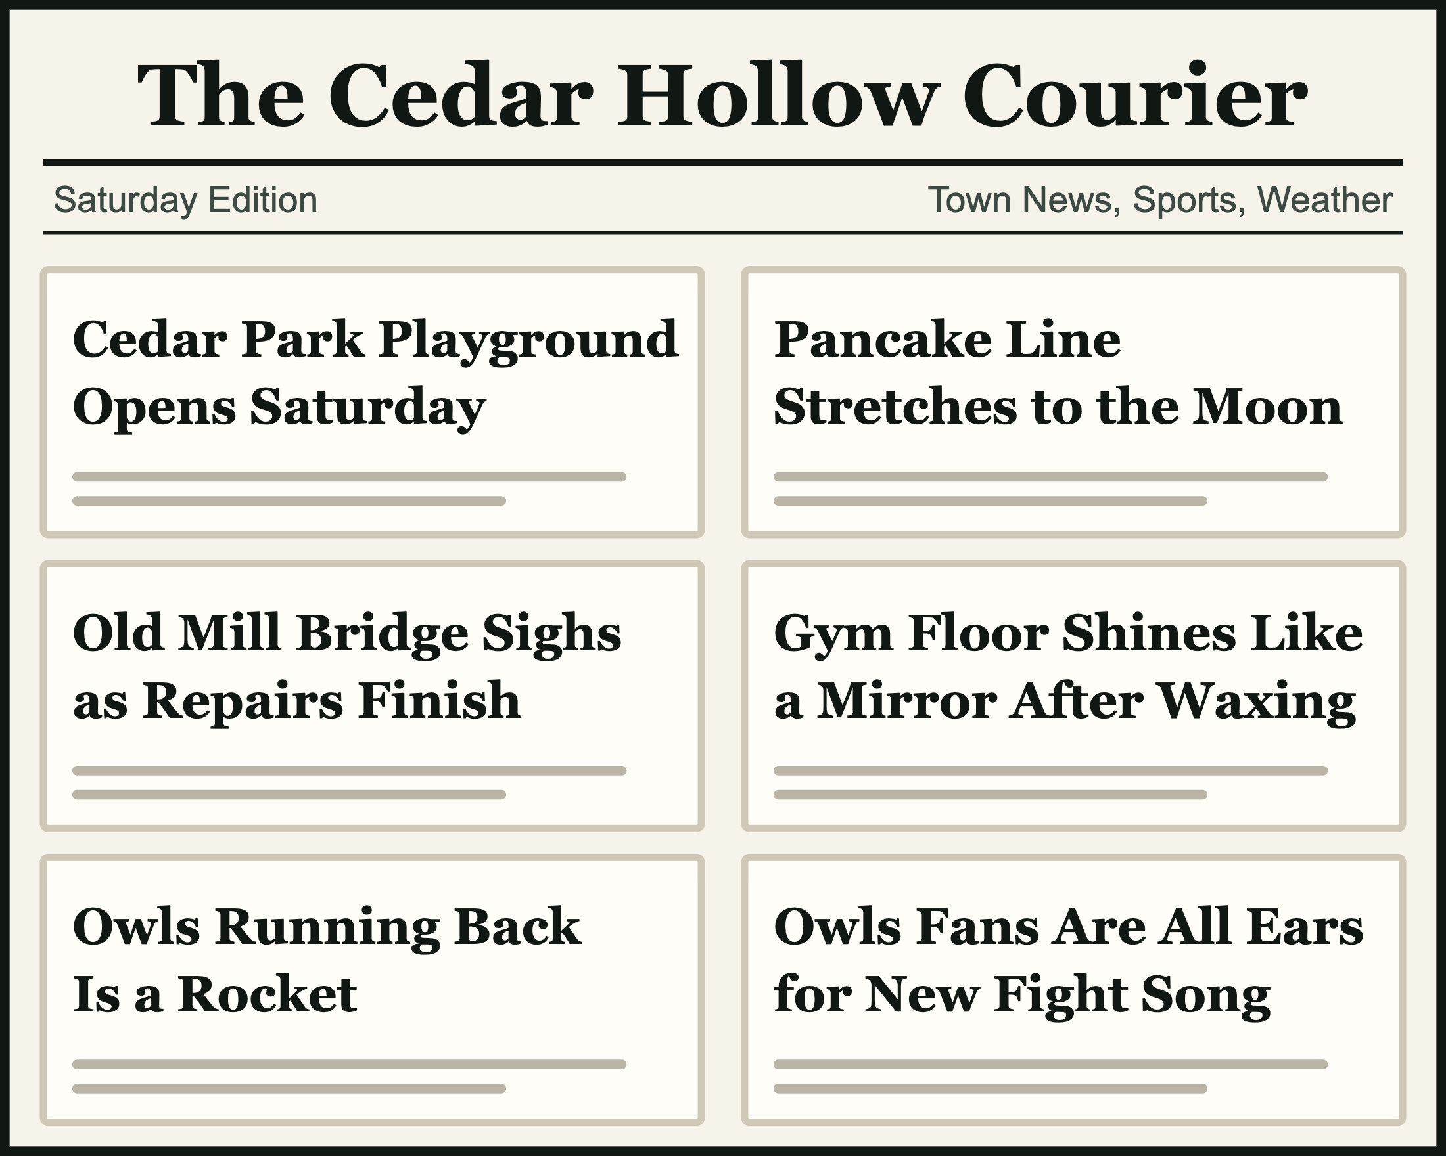
Stop the presses!
Read the six Courier headlines.
Which headline means exactly what it says?
Turn and talk: what do the other five really mean?
GBG Education · Cedar Hollow Case Files
2
Notes:
Give pairs one minute. Answer: "Cedar Park Playground Opens Saturday" is the only literal headline. Do not name the devices yet; just collect what the others really mean: a very long pancake line (hyperbole), a bridge that cannot really sigh (personification), a floor compared to a mirror with like (simile), a running back who is very fast (metaphor), and fans who are eager to listen (idiom: all ears). Tell students these five tricks have names, and that is today's work.

Slide 3
Today's learning target
Target: I can find figurative language and decode what it means.
I can name the five kinds and point to each clue.
I can decode what a phrase really means in the story.
I can explain how word choice creates a mood.
GBG Education · Cedar Hollow Case Files
3
Notes:
Read the target aloud. Point out the verbs: find, name, decode, explain. Detectives decode: they figure out what a message really means. Tell students they will return to these "I can" statements on the exit ticket and choose the one they met.

Slide 4
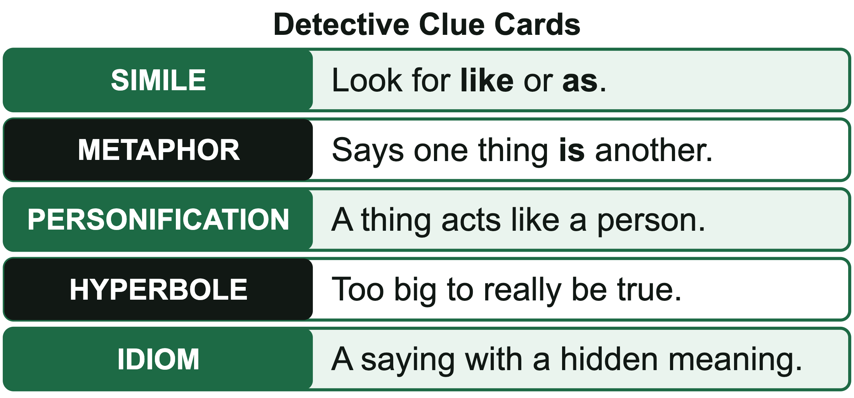
Five kinds of figurative language
Simile: compares different things with like or as
Metaphor: says one thing is another
Personification: a thing acts or feels like a person
Hyperbole: an exaggeration too big to be true
Idiom: a common saying with a hidden meaning
GBG Education · Cedar Hollow Case Files
4
Notes:
Give one quick example of each: the puddles shone like coins (simile); the Cedar River is a mirror at sunset (metaphor); the streetlights blinked awake (personification); I have read a billion pages this week (hyperbole); break a leg, which means good luck (idiom). Say plainly: an idiom is a fixed, common saying that people learn as a whole, like a vocabulary word. Its meaning cannot be figured out from the exact words. One more tip for later: the word like does not always make a simile. In "Owen would like a turn on the swings," like means want, and nothing is compared, so it is literal. Challenge players will see this idea in the game.

Slide 5
Watch me think: the four detective questions
"The morning fog tiptoed down Elm Street."
1. Literally true? No. Fog has no feet.
2. Clue: a human action, so personification.
3. Meaning: the fog moved in slowly and quietly.
4. Why: the morning feels hushed and mysterious.
GBG Education · Cedar Hollow Case Files
5
Notes:
Think aloud slowly, one question at a time. Write the four questions on the board, because students will use them all lesson: Is it literally true? What is the clue? What does it really mean? Why did the writer use it? Point out that these are the moves in the game: searching a scene asks "literally true?", the interview asks for the clue (the device), following the lead asks what it really means, and Challenge players also explain why. Ask: how would the mood change if the fog stomped down Elm Street? (It would feel loud or threatening.)

Slide 6
Quick check: name it
A. Tomás waited a century for the bus.
B. The puddles glittered like coins in the sun.
C. Keep an eye on the bake sale table.
D. The streetlights blinked awake at dusk.
E. The Cedar River is a mirror at sunset.
Show fingers: 1 simile, 2 metaphor, 3 personification, 4 hyperbole, 5 idiom
GBG Education · Cedar Hollow Case Files
6
Notes:
Read each sentence aloud and have students show fingers at the same time. Answers: A is 4 (hyperbole: no one waits a hundred years for a bus), B is 1 (simile: like coins), C is 5 (idiom: keep an eye on means watch carefully), D is 3 (personification: streetlights cannot wake up), E is 2 (metaphor: the river is a mirror, no like or as). Students who miss two or more start at Level 1. Students who get all five and can explain why may start at Level 3.

Slide 7
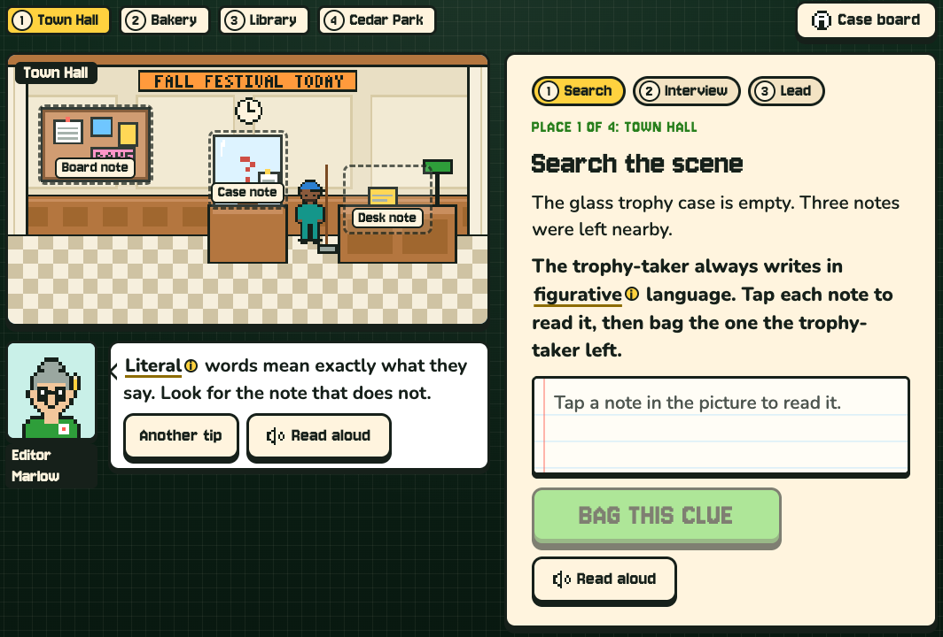
How to play Cedar Hollow Case Files
Type your group's code: WHIT8B-1, WHIT8B-2, or WHIT8B-3.
Search the scene: bag the note written in figurative language.
Interview the witness: name the device.
Follow the lead: decode the meaning. Wrong meaning, dead end!
Crack the case, then type your completion code into the assignment.
GBG Education · Cedar Hollow Case Files
7
Notes:
Write the three codes on the board by group: WHIT8B-1 is Support, WHIT8B-2 is On Level, WHIT8B-3 is Challenge. Everyone with the same code gets the same notes and witnesses in the same order, so partners can help each other. The case has four places: Town Hall, Hollow Hearth Bakery, the library, and Cedar Park. At each place students tap the notes in the picture, bag the one written in figurative language, name the device in what the witness says, and pick what the witness really means. Each meaning is tied to a place, so a literal reading (like thinking "hit the books" means hitting something) sends the detective to a dead end with an explanation, then back on the trail. Challenge players also explain why the speaker chose those words, and Challenge has no hints. Support players get hints and a second try. A run takes about 10 to 15 minutes. The completion code starts with the class code and level, then the score and a 3-character check, so students should copy it exactly. To check codes, tap the small "Made by GBG Education" credit 5 times and enter the teacher passphrase from the lesson plan. Keep the passphrase private.

Slide 8
Exit ticket
1. Write your completion code.
2. Write one sentence about Cedar Hollow Middle School that uses figurative language.
3. Label the kind and decode what it really means.
4. Circle the "I can" statement you met today.
GBG Education · Cedar Hollow Case Files
8
Notes:
Collect exit tickets at the door. A strong answer names the device correctly and decodes the real meaning, for example: "Our hallway is a river at 8 a.m." (metaphor: the hallway is crowded with students all moving in one direction). Sort the tickets into got it, almost, and not yet to plan tomorrow's warm-up.

