Slide 1
GBG EDUCATION
Checks and Balances
Social Studies: U.S. Government · Grades 9-12
Mr. Ashford · Cedar Hollow High School
Lesson introduction · 50 minutes
Notes:
Welcome. Today we look at how the Constitution splits power among three branches, and how each branch can stop the others from going too far. By the end of class you will be able to trace a vetoed bill and name the checks each branch holds.

Slide 2
Who should hold all the power?
Imagine the Cedar Hollow student council president could write the school rules, enforce them, and judge every dispute about them.
Turn and talk: what could go wrong?
"The accumulation of all powers, legislative, executive, and judiciary, in the same hands ... may justly be pronounced the very definition of tyranny." (Federalist No. 47, 1788)
GBG Education · Checks and Balances
2
Notes:
Give pairs one minute, then take two ideas (for example: unfair rules, no one to appeal to, no way to remove a bad leader). Connect their answers to the quote. Federalist No. 47 was published under the pen name Publius and is generally credited to James Madison. Tell students the framers answered this problem in two ways: separate the powers, then give each branch ways to check the others.

Slide 3
Today's learning target
Target: I can explain how the Constitution divides power among three branches and how each branch checks the others.
I can name each branch, its article, and its main job.
I can trace a bill through both chambers, the President, and a veto.
I can decide whether a vote reached two-thirds.
GBG Education · Checks and Balances
3
Notes:
Read the target aloud. Ask students to rate themselves 1 to 4 on each I can statement now; they will rate again at the exit ticket.

Slide 4
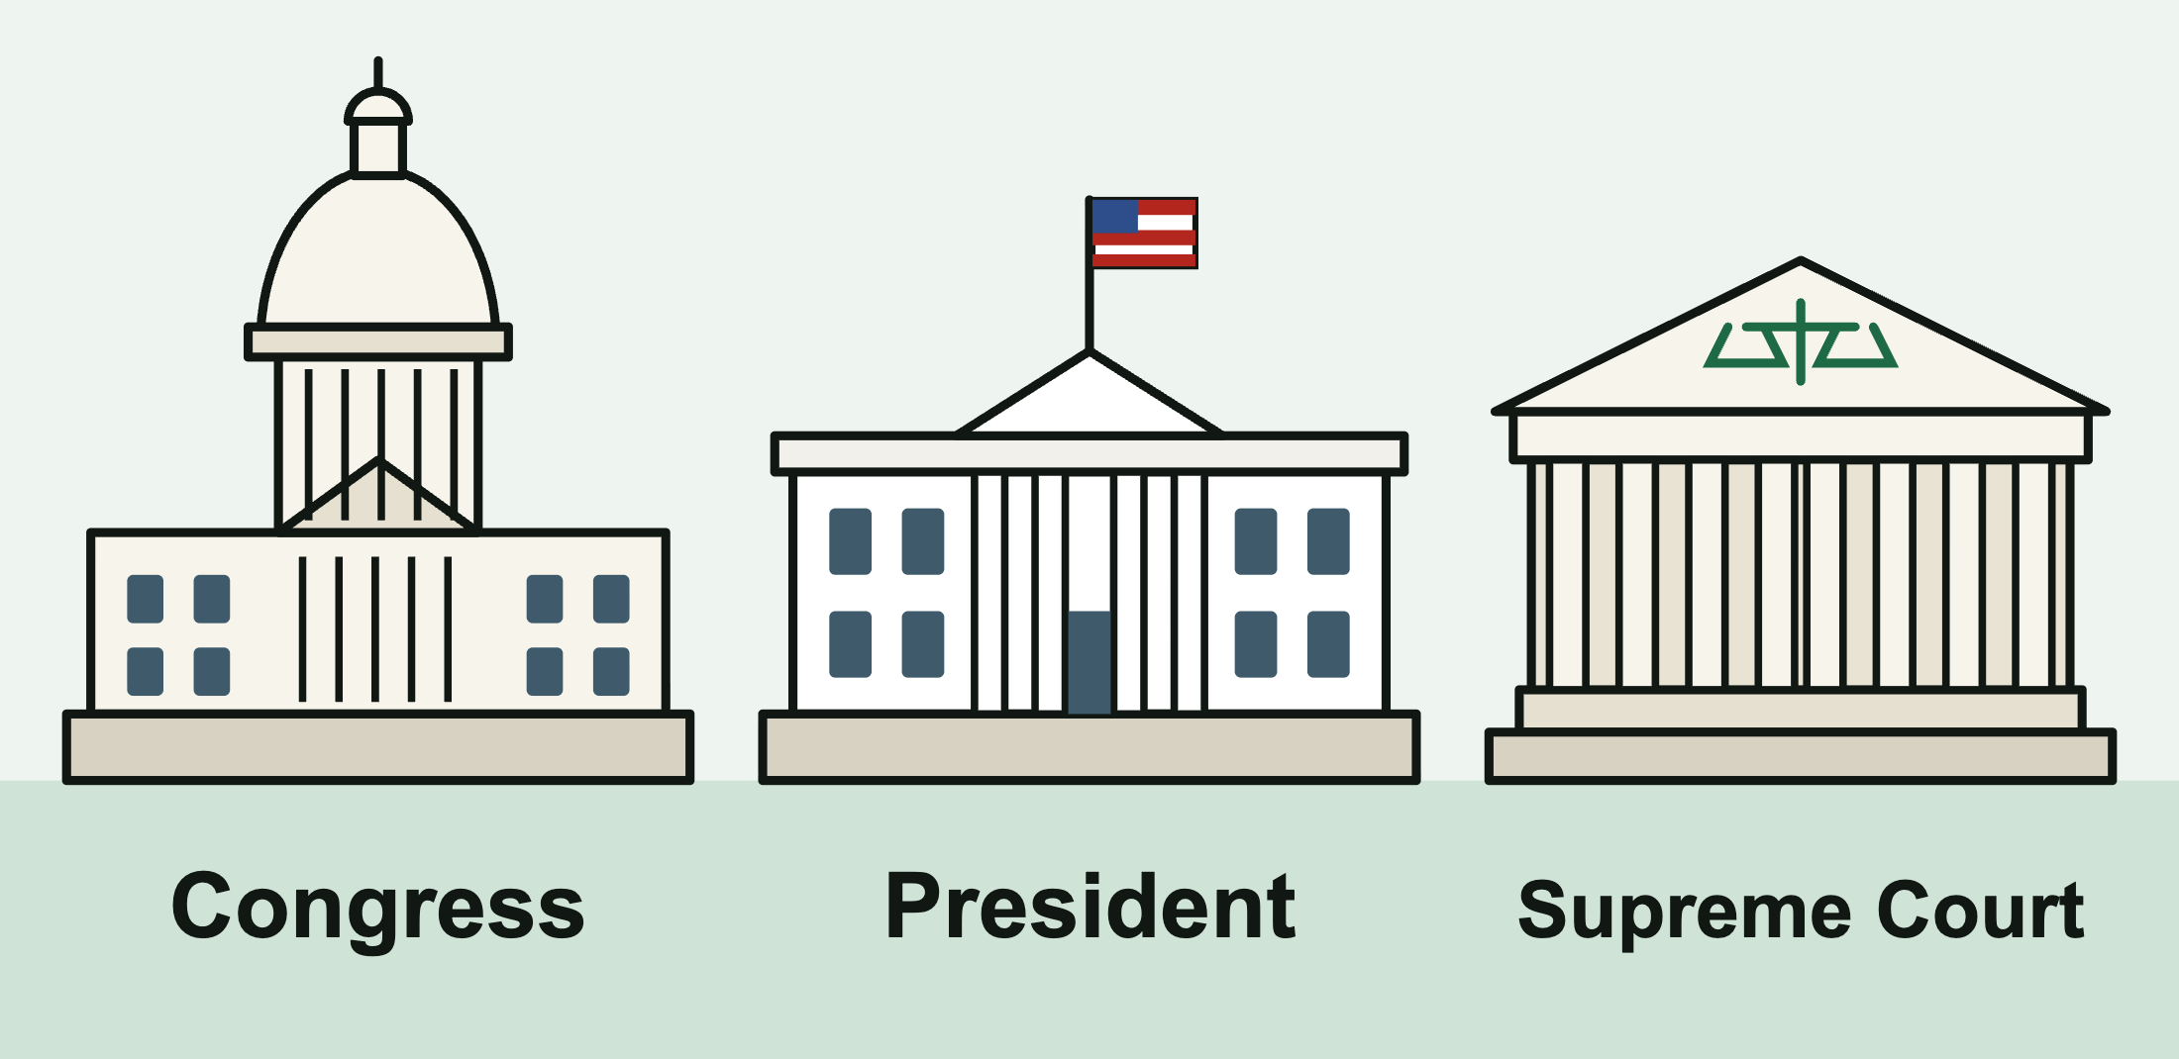
Three branches, one Constitution
Article I: Congress (legislative) makes the laws.
Article II: the President (executive) carries out the laws.
Article III: the federal courts (judicial) interpret the laws.
Separation of powers: no one branch does everything.
GBG Education · Checks and Balances
4
Notes:
Point to each building. Congress is bicameral: the House of Representatives and the Senate. Article III creates the Supreme Court and lets Congress set up lower federal courts. Emphasize that Article I is the longest article and that Section 8 lists most of Congress's powers.

Slide 5
Key vocabulary
Checks and balances: each branch can limit the other two.
Federalism: power split between the national and state governments.
Veto / override: the President rejects a bill; two-thirds of both chambers can pass it anyway.
Impeach: the House formally charges an official (not removal).
Judicial review: courts strike down laws that conflict with the Constitution.
GBG Education · Checks and Balances
5
Notes:
Stress the common mix-up: federalism is national versus state power; separation of powers is the split among three branches of the national government. Impeachment is a charge, like an indictment. Removal needs a Senate conviction by two-thirds of the senators present (Article I, Section 3). Judicial review is not written out in Article III; the Court established it in Marbury v. Madison (1803).

Slide 6
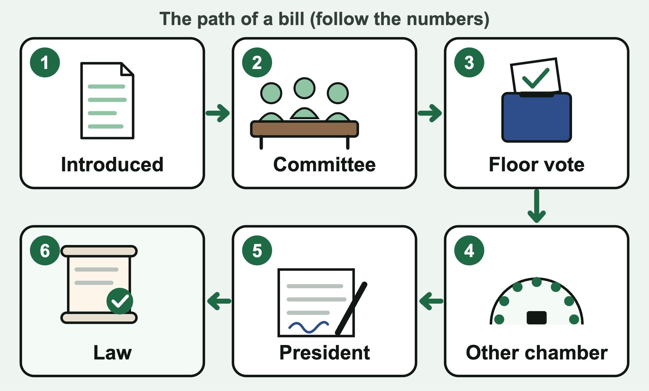
Worked example: veto, then override
The (fictional) National Trails Act passes the House and the Senate.
The President vetoes it and returns it, with objections, to the House, where it started.
Two-thirds of the House vote yes, then two-thirds of the Senate.
It becomes law without the President's signature (Article I, Section 7).
GBG Education · Checks and Balances
6
Notes:
Trace the path on the picture: steps 1 to 5, then the veto sends the bill back to the chamber where it started. Point out that the veto and the override are both in Article I, Section 7, not Article II. Then ask: once it is law, can the courts still strike it down? Yes. An override makes a bill a law, but every law must still follow the Constitution.

Slide 7
Who checks whom?
President on Congress: veto.
Congress on the President: override, impeachment and removal, Senate consent to appointments and treaties, power of the purse.
Courts on both: judicial review.
On the courts: the President nominates and the Senate confirms judges; Congress can impeach judges; Congress and the states can amend the Constitution to reverse a ruling.
GBG Education · Checks and Balances
7
Notes:
Sketch three circles on the board and draw an arrow for each check as you go. Treaties need two-thirds of the senators present (Article II, Section 2). Proposing an amendment takes two-thirds of both chambers, and three-fourths of the states must ratify it (Article V). Do not give a vote number for confirming nominees or for the House impeaching: the Constitution does not set one.

Slide 8
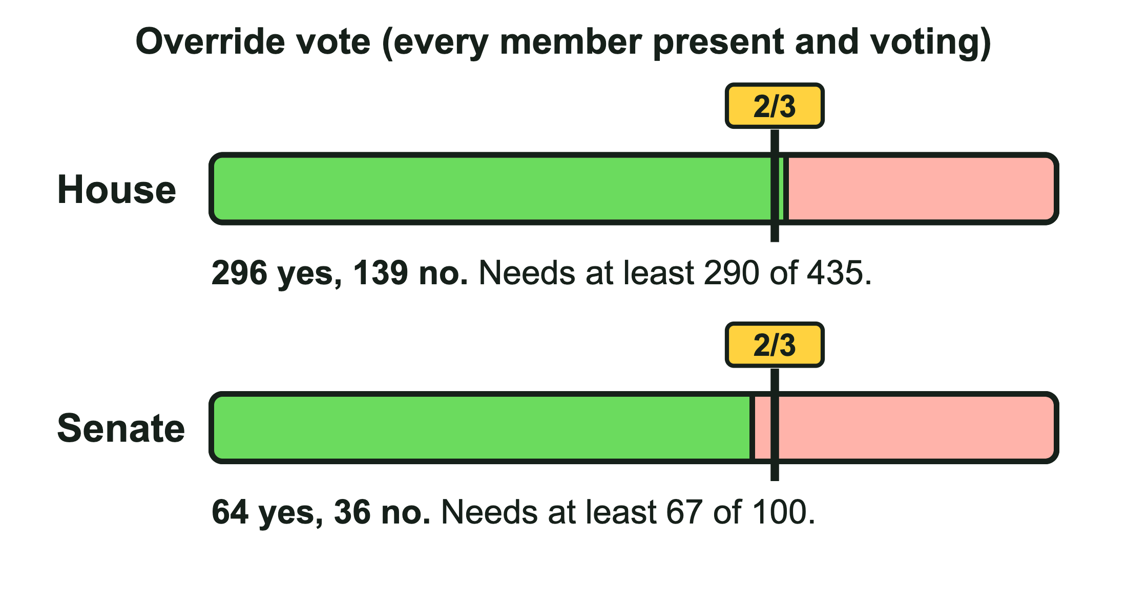
How to play
Type your class code, for example ASH-GOV-2 (the last digit is your level).
Each turn, move a bill, case, nomination, or treaty through the branches.
Play each role and pick the move the Constitution requires.
Two-thirds is 290 of 435 and 67 of 100.
Copy your completion code at the end.
GBG Education · Checks and Balances
8
Notes:
Write the three codes on the board by group: ASH-GOV-1 (Support), ASH-GOV-2 (On Level), ASH-GOV-3 (Challenge). Everyone with the same code gets the same turns, bills, and vote tallies, so partners can compare. Students run the Cedar Hollow High School Model Government: at each stop they play the House, the Senate, the President, or the courts, and the town reacts to every move with a Courier headline. Walk through the picture: the House reached two-thirds (296 is at least 290), but the Senate fell short (64 is less than 67), so the veto stands. The read-aloud button reads each situation where the browser supports it. Plan on 10 to 15 minutes.

Slide 9
Quick check
The House impeaches an official. Is the official removed?
The Senate votes 66 to 34 to override a veto. Does the override pass the Senate?
Which case established judicial review?
Is federalism the same as separation of powers?
GBG Education · Checks and Balances
9
Notes:
Answers: (1) Not yet. The Senate holds a trial, and two-thirds of the senators present must vote to convict before removal. (2) No. With all 100 senators voting, two-thirds is about 66.7, so it takes 67 (Article I, Section 7). (3) Marbury v. Madison (1803). (4) No. Federalism divides power between the national and state governments; separation of powers divides national power among three branches.

Slide 10
Exit ticket
Write your completion code.
Name one check: which branch uses it, and which branch does it limit?
Rate yourself again on today's I can statements.
GBG Education · Checks and Balances
10
Notes:
Collect on paper or as an LMS question. Sort tickets into got it, almost, and not yet to plan tomorrow's warm-up. Common error to watch for: saying impeachment removes an official.

